Slide 1

DEC Launchpad Bootcamp
Capstone Project Presentation
Presenter: Oyelaran Paul Temitope

Slide 2
Problem Statement
SupplyChain360 faces fragmented, siloed data across PostgreSQL, S3, and Google Sheets, leading to poor visibility, inefficient inventory, and delayed decision-making due to manual reporting.
Solution:
This project addresses the issue by building a unified, automated ELT data platform (Airflow, dbt, Terraform) that centralizes data into a cloud warehouse, enabling real-time insights to optimize inventory, monitor supplier performance, and reduce revenue loss.
Key Deliverables:
Automated ingestion pipelines that handle messy data and store history in Parquet
dbt-powered marts for stockouts, supplier lead times, and warehouse performance
Infrastructure fully provisioned with Terraform
CI/CD pipeline with testing
Impact:
Replaces manual spreadsheets with real-time insights, enabling better inventory control, reduced stockouts, and improved supplier performance—driving significant cost savings.

Slide 3
Project Objective
Eliminate Data Fragmentation (Source-to-Raw Layer):by building an automated ingestion pipeline that consolidates data from AWS S3, Google Sheets, and PostgreSQL into a centralized store, preserving raw data in standardized Parquet format with metadata (e.g., timestamps) while addressing historical data inconsistencies.
Establish an Analytical Data Warehouse (Raw-to-Mart Layer): Build a structured Data Warehouse (using a platform like BigQuery, Redshift, or Snowflake). Clean and standardize raw data before utilising dbt to model it into robust Fact and Dimension tables. This architecture must support analytical queries covering stockouts, supplier delivery performance, warehouse efficiency, and regional demand.
Implement end-to-end orchestration with Airflow: to manage extraction, loading, cleaning, transformation (via dbt), and data quality checks, using production-grade practices like idempotency, incremental loads, retries, and failure alerts.

Slide 4
Project Limitation
Erratic Power Supply
Poor Network
School Project and Exam

Slide 5
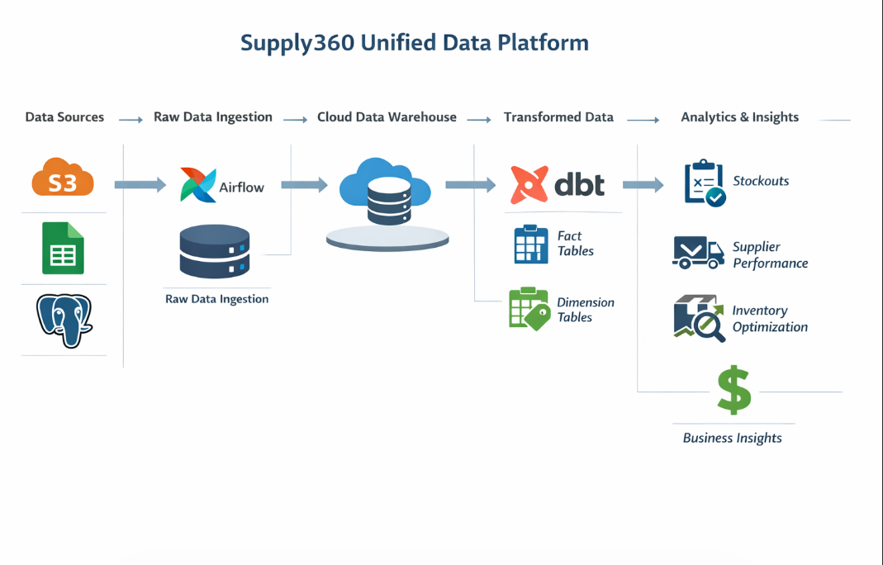

Slide 6
Learning Outcomes
Gained practical experience with cloud data warehouses and optimized them for analytical workloads.
Translated business needs into data solutions, enabling insights on stockouts, supplier performance, and inventory optimization
Built a production-grade ELT data pipeline, gaining hands-on experience in designing scalable data architectures.

Slide 7
THANK YOU FOR LISTENING

